Slide 1
Object Detection for Wildlife Conservation
Pratyay, Nayan, and Richard

Slide 2
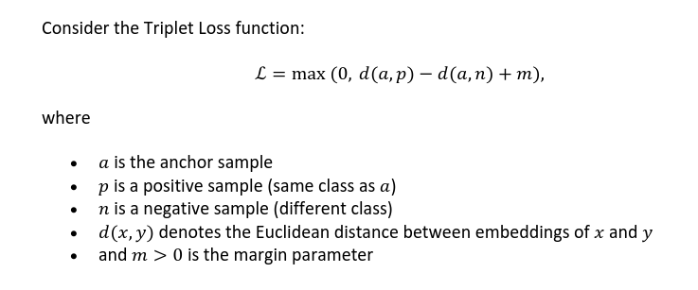
Unraveling the Triplet
Loss function
Images of the same class should be close together.
  d(a, p) is small
  intra-class distance
Images of different classes d(a, n) should be far apart.
  d(a, n) is large
  inter-class distance
If the sum d(a, p) - d(a, n) + m is <= 0
  d(a, n) >= d(a, p) + m, the distance between a and n is larger than the distance between a and p, because m is greater than 0
  the loss is 0 in this case
  if m is too small this will always be the case and cause the training to stop
If the sum d(a, p) - d(a, n) + m is > 0
  d(a, n) < d(a, p) + m, this means the distance between a and n is too close to the distance between a and p
  the loss in non zero and positive = d(a, p) - d(a, n) + m
  if m is too large it will prevent convergence of the loss function

Slide 3
How does m affect d(a, n) in the embedding space
The embedding space contains all feature vectors (embeddings) produced by the neural network for every image
In the equation d(a, n) represents the inter-class distance between feature vectors in the embedding space.
Looking at the condition where the max function produces a positive and non-zero value:
d(a, n) < d(a, p) + m
This means that a larger margin will allow for a larger inter-class distance, and a small margin will force the inter-class distance to be smaller.
For the condition where the loss function becomes 0:
d(a, n) >= d(a, p) + m
It’s apparent that the same relationships exist.

Slide 4
The condition for the expected loss becoming 0
Note: For the triplet loss function the expectation operator interprets as the average over all possible triplets
for L = max(0, d(a, p) - d(a, n) + m) the max function will output 0 when it’s argument is less than or equal to 0:
d(a, p) - d(a, n) + m <= 0 ⇔ d(a, n) >= d(a, p) + m
So for each triplet the loss function is zero when the above inequality is true. For the expected loss to be zero, every triplet in the data distribution must have zero individual loss. This implies:
E[L] = 0 ⇔ P(d(a, n) >= d(a, p) + m) = 1
and means that the negative sample is always at least a margin m farther away from the anchor than the positive sample is.

Slide 5
Using a trained embedding space for OOD detection
Task 2.1
For each region in the image that may contain an object, the model extracts a feature vector. The deep metric learning model maps each feature vector into clusters in an embedding space. The embeddings of same-class objects will be close together and objects of different classes will be far apart (background vegetation, non-bird objects, etc…)
Given the embeddings from the deep metric learning model we can detect OOD samples by:
Summarizing each cluster’s center using a prototype vector
  mu_c = 1/N_c*sum(z_i) over all i’s that are elements of the class c.
    z_i are embeddings belonging to class c
Calculating an OOD score by computing an embeddings distance to all class prototypes, mu_c. Then find the minimum distance between that embedding to any known class cluster.
  higher scores, further distances, would mean the sample is more likely OOD.
To decide whether the sample is OOD create a threshold, for example the farthest known in-class sample to mu_c and add 10% of that value and use that as a threshold. Any distances above that can be considered OOD.

Slide 6
OOD in the embedding space
Task 2.2
Each known class forms a tight cluster of embeddings around a prototype, mu_c, in the embedding space
Any object detected in an image is mapped to a point z in this space
If z falls inside one of the clusters it is likely a known species, in-distribution sample
if z falls outside one of the clusters is likely an out of distribution sample
OOD samples end up farther from all class cluster centers than legitimate samples.

Slide 7
OOD in the embedding space
Assumptions
each class c forms a compact cluster around its prototype mu_c
clusters are disjoint (well separated)
Distances are euclidian
Definitions
Prototype: mu_c = 1/N_c*sum(z_i) over all i’s that are elements of the class c.
Class radius: r_c = max||z_i - mu_c|| over all i’s that are elements of the class c.
Max in-class radius: r_max = max_c(r_c)
Nearest-prototype distance for test object z: D_min(z) = min_c||z - mu_c||
Key inequalities
In-Distribution: D_min(z_ID) <= r_max
Out-of-Distribution: D_min(z_OOD) > r_max

